Slide 1





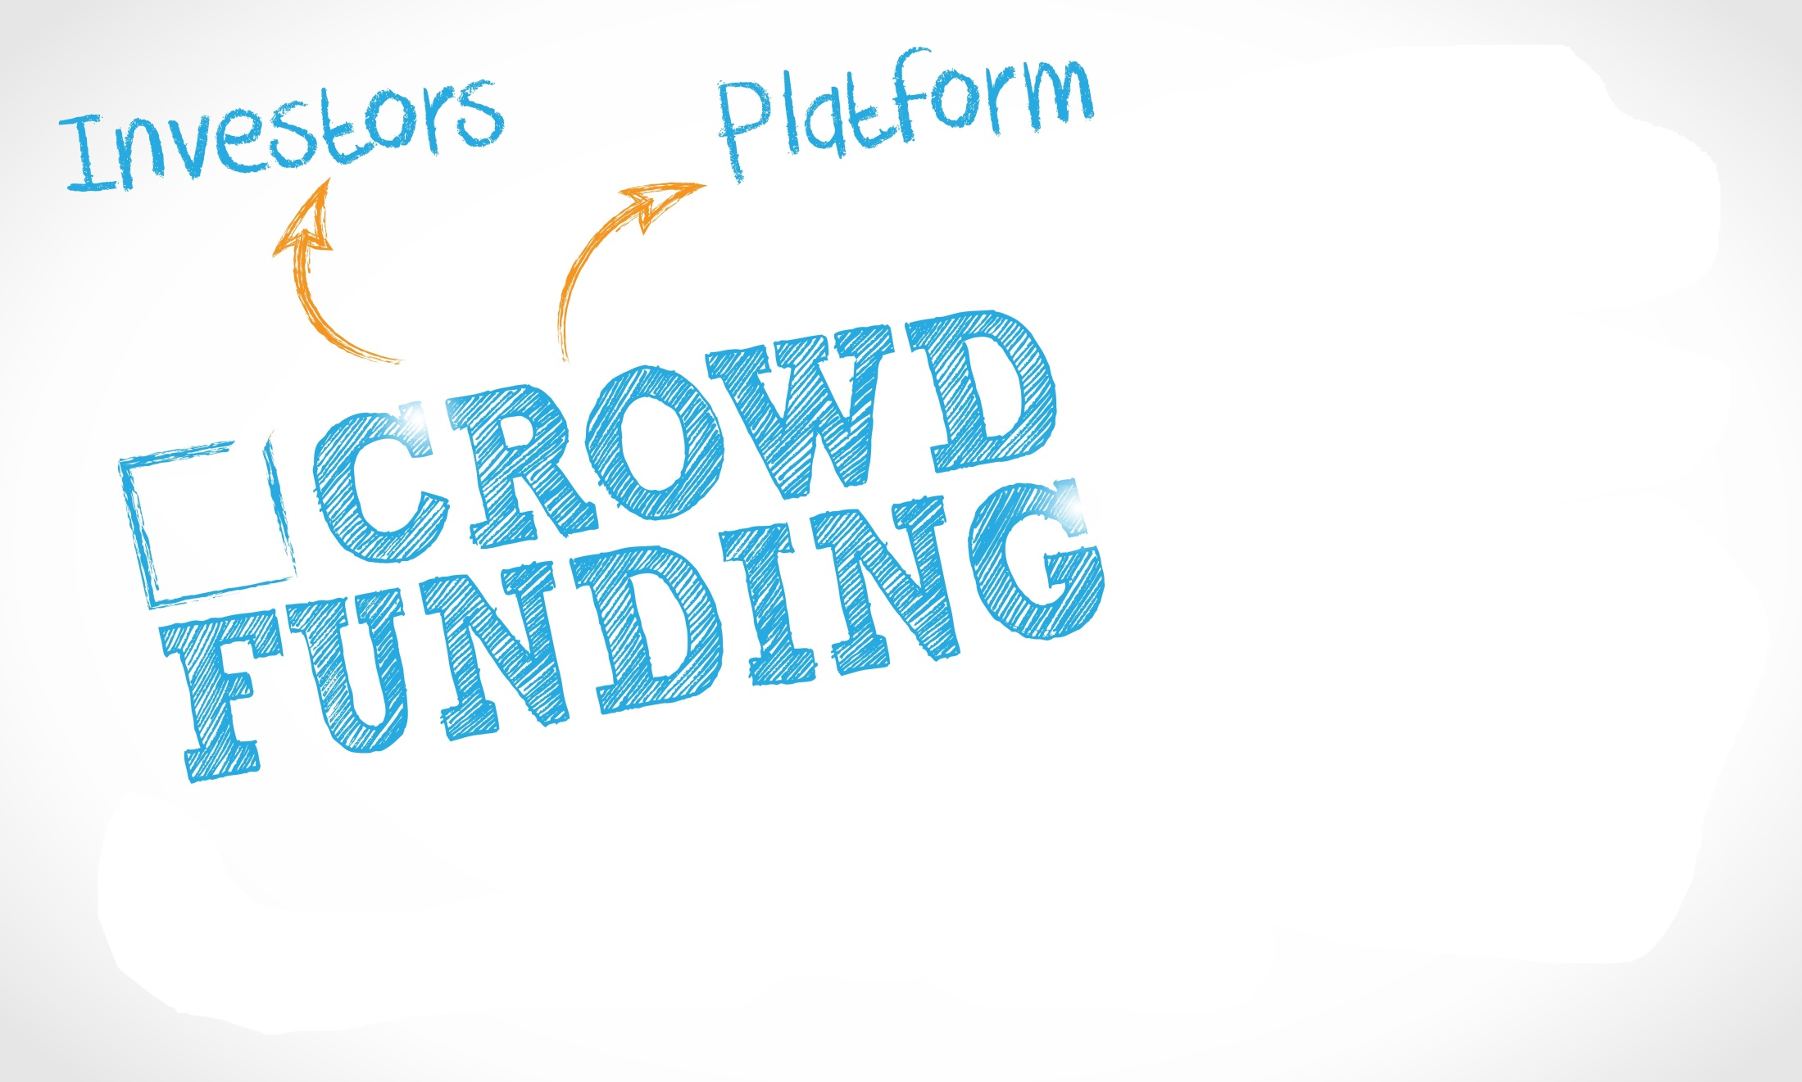
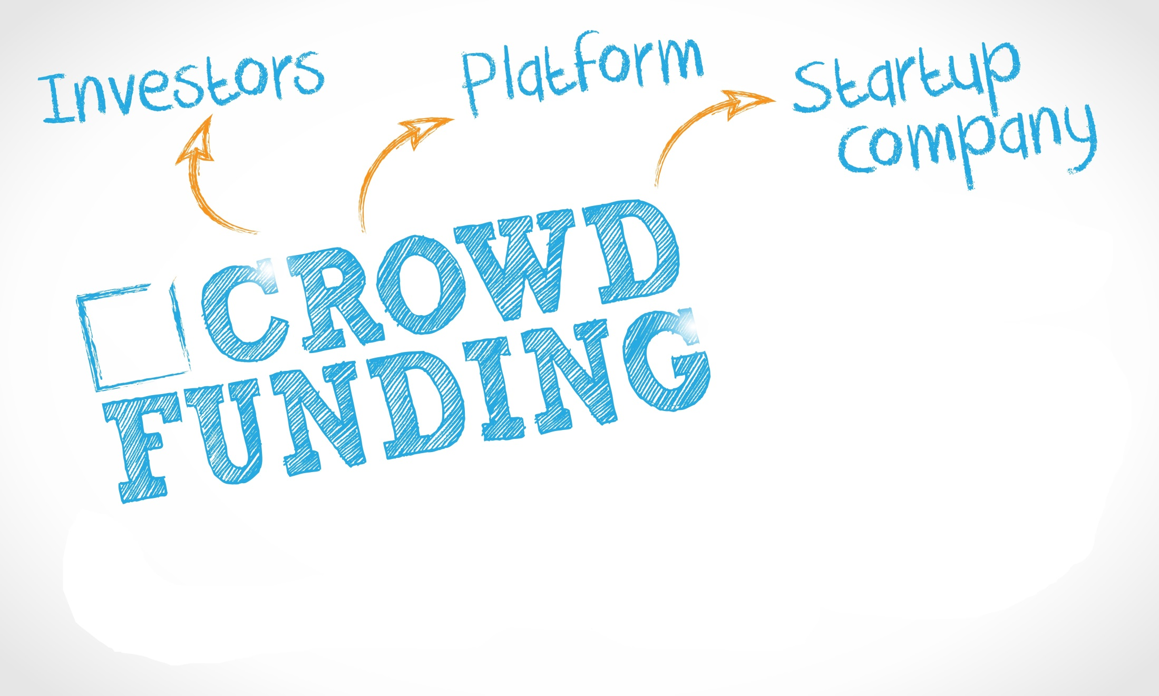
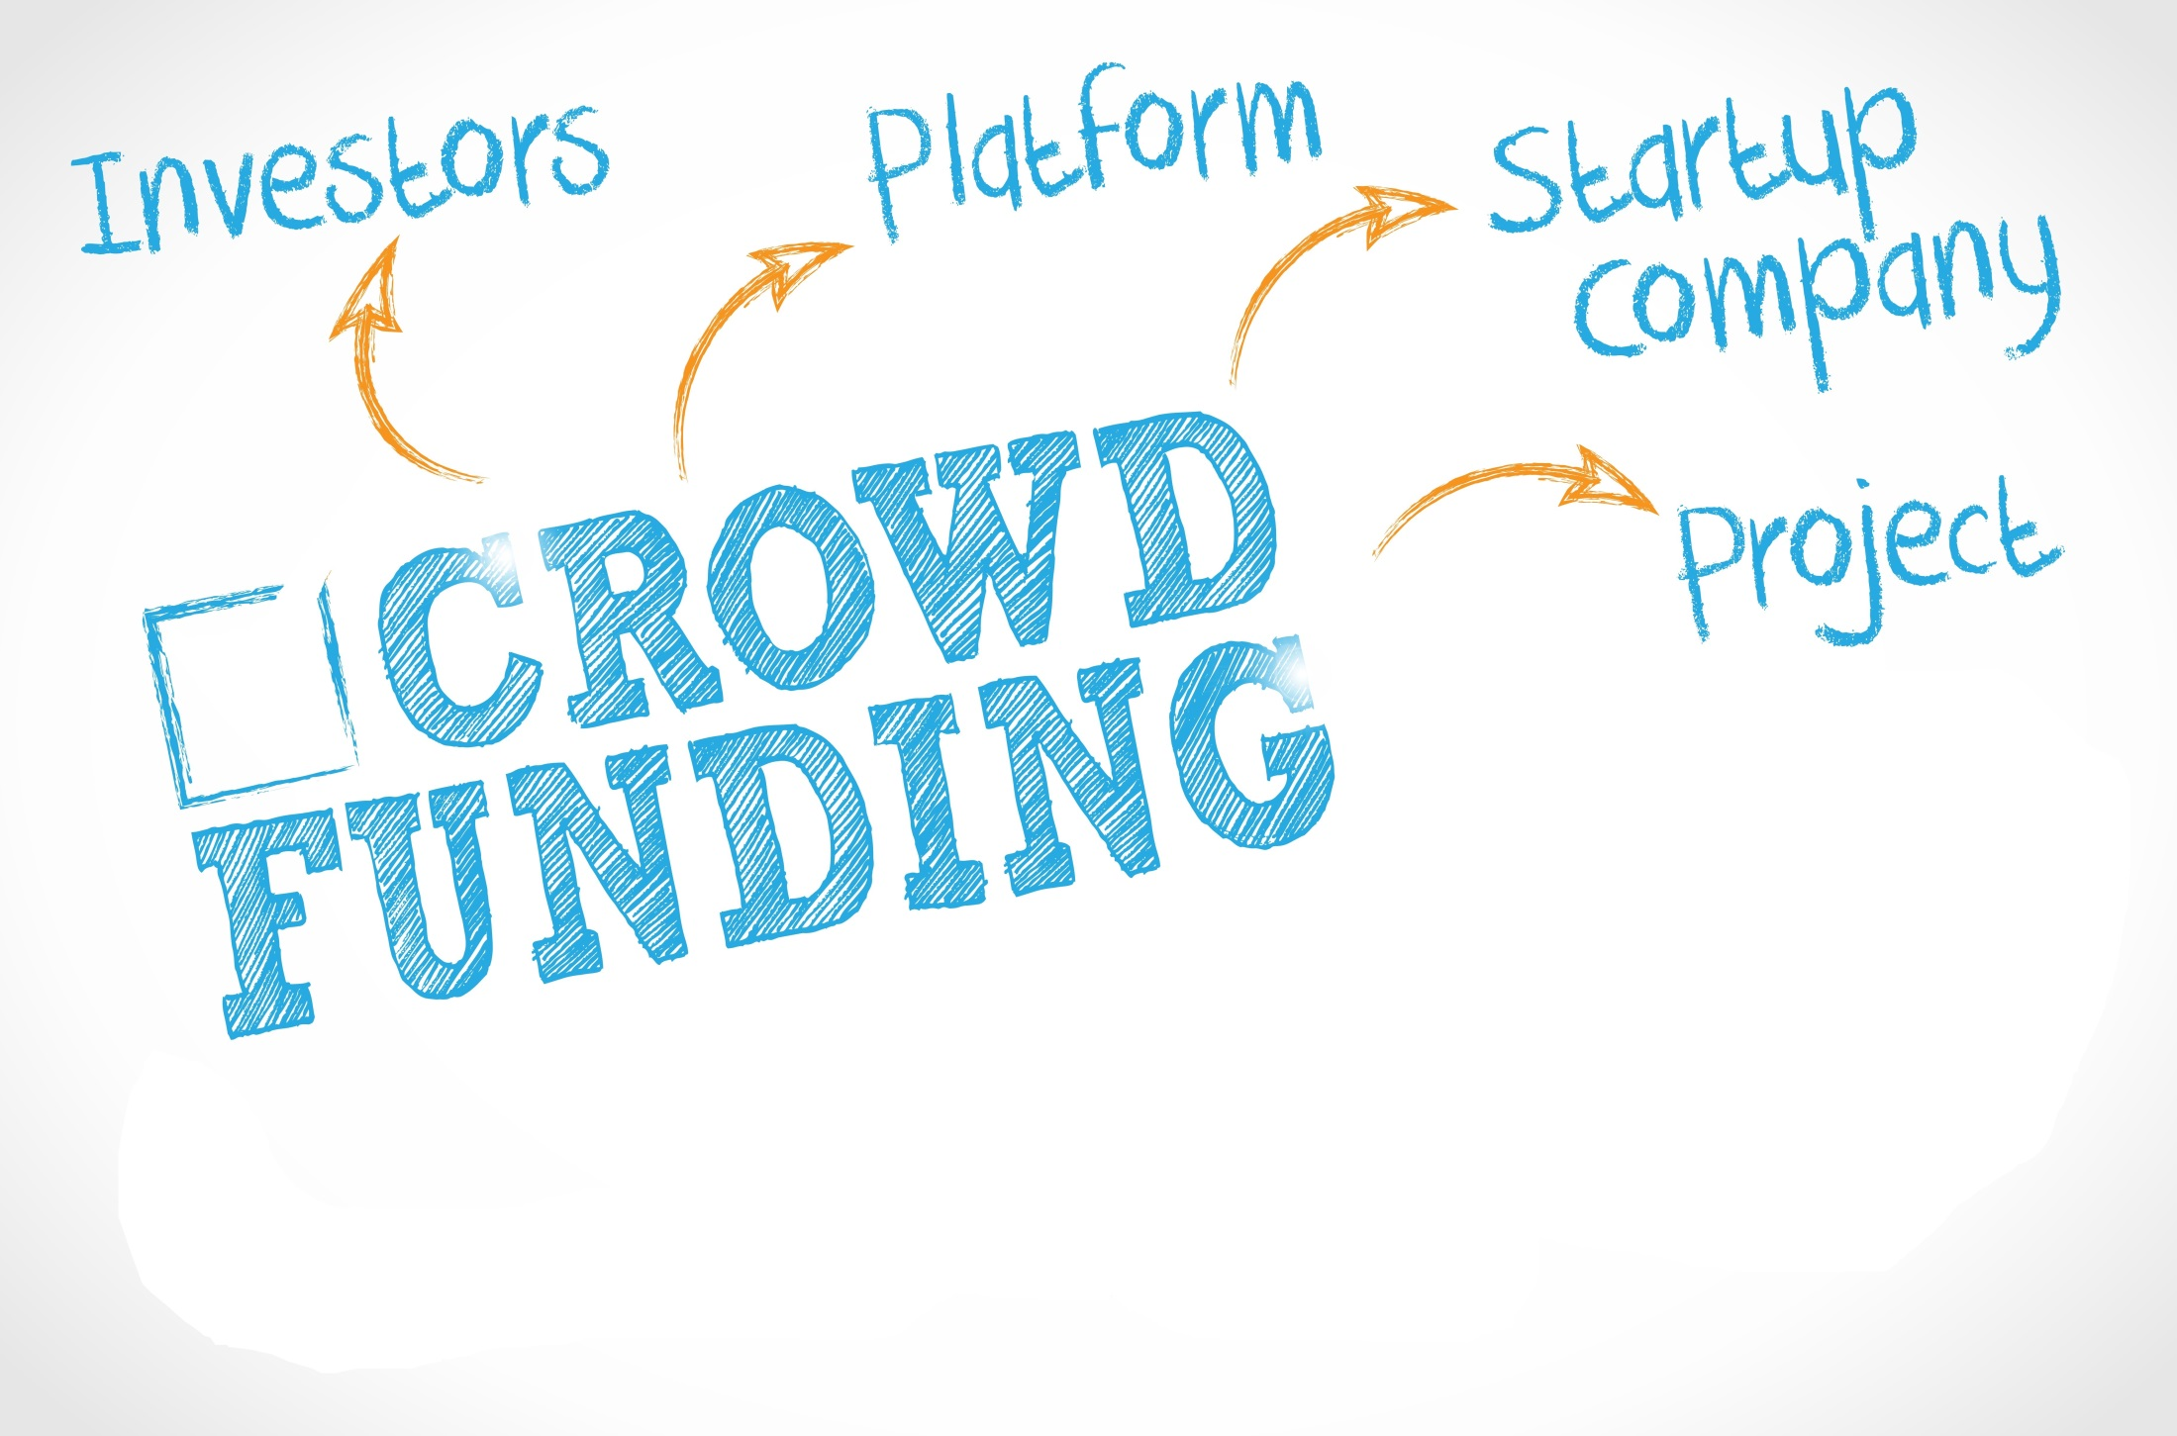
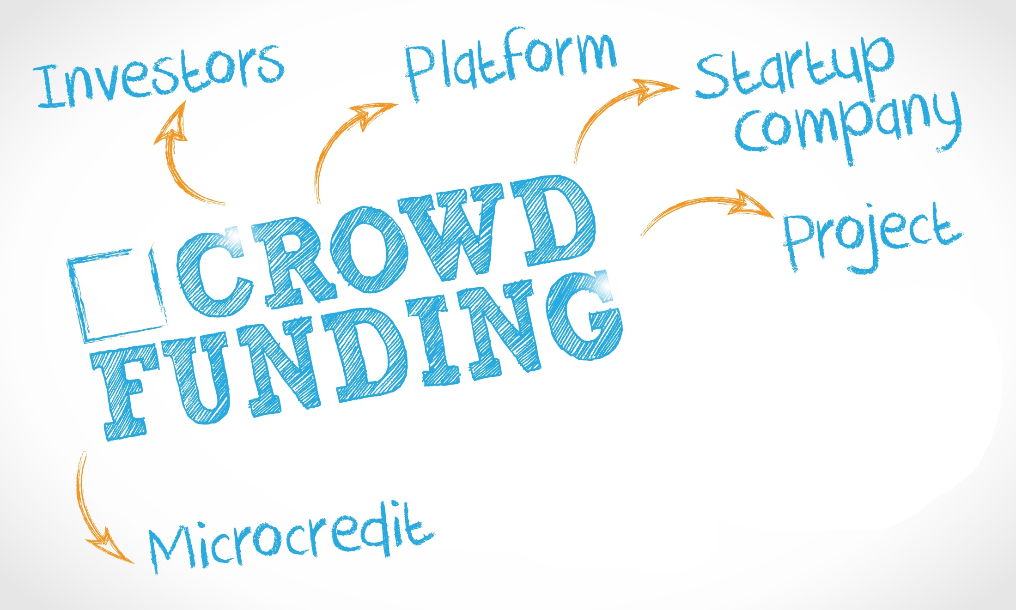
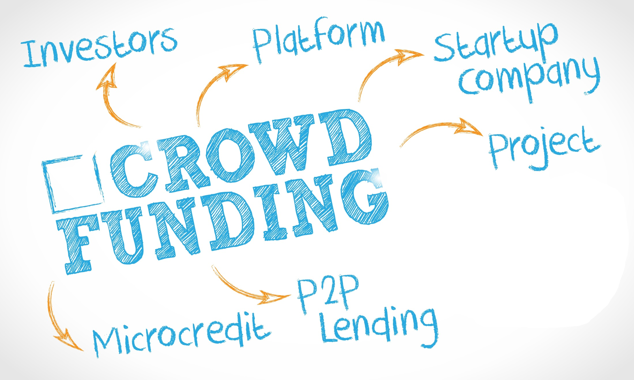
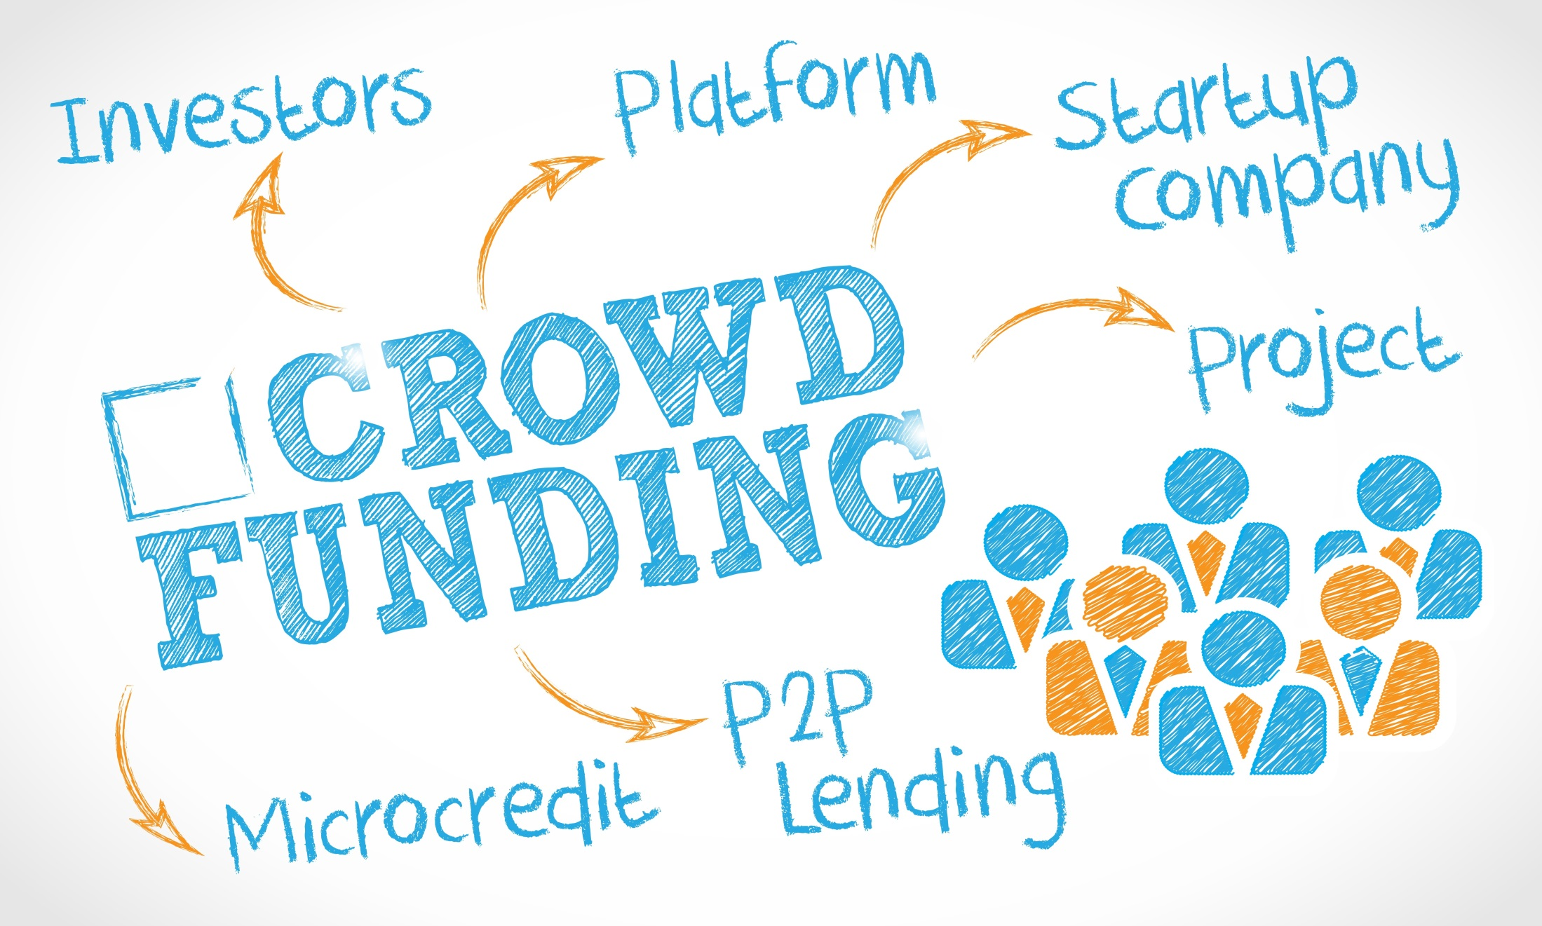
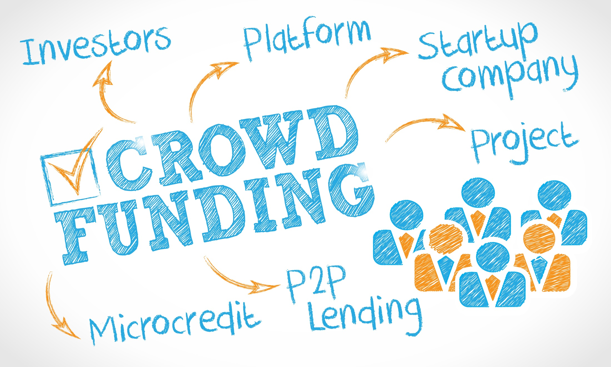




UNDERSTANDING DEBT AND EQUITY CROWDFUNDING FROM A LEGAL PERSPECTIVE

Slide 2


What Is Crowdfunding?
In today’s economy the term “crowdfunding” can take on many contexts but it is, by definition, the practice of funding a project or venture by raising small amounts of money from a large number of people, most commonly via the Internet
When a person/business attempts to raise money through crowdfunding, this process is often called a “crowdfunding campaign” or simply a “campaign”

Slide 3

What Is Crowdfunding?
With debt and equity based campaigns, like Kickstarter (and other rewards-based campaign sites), an entrepreneur starts a campaign in order to raise money to fund their new business, create a new product, get working capital, etc.
Unlike Kickstarter however, a contributing person in a debt/equity campaign will be making an investment in the entrepreneur’s business
Put simply, in debt and equity based campaigns, a person will give money to an entrepreneur in return for a piece of the action

Slide 4



What Is Crowdfunding?
There are four (4) main types of crowdfunding campaigns:
  Donation-based campaigns;
  Rewards-based campaigns;
  Debt-based campaigns; and
  Equity based campaigns
  Each of these types of crowdfunding campaigns is differentiated by what (if anything) the person contributing the money can expect to receive in return
The most commonly known type of crowdfunding campaigns today are rewards-based campaigns. These are the projects you see in the news and other media raising money through sites such as Kickstarter, Indiegogo, etc.

Slide 5
Federal Regulations
JOBS Act:
  On March 27, 2012, Congress passed the Jumpstart Our Business Startups (JOBS) Act, a bipartisan effort in both the House and the Senate to ease the regulatory burdens on smaller companies and facilitate capital formation. President Obama signed the legislation into law on April 5, 2012
Main Provisions:
  Title I: Creates a transitional "on-ramp" for a new category of issuer, emerging growth companies (i.e. total annual gross revenues of < $1 billion), easing registration requirements in order to encourage them to pursue IPOs
  Title II: Allows for “crowdfunding” by (and public solicitation of) “accredited investors.
  Title III: Allows for “crowdfunding” by (and public solicitation of) all investors (i.e. accredited and non-accredited)
  Title IV (Regulation A+): Modifying the existing “Regulation A” to provide for, among other things, an expansion of the exemption to cover offerings of securities up to $50 million (versus the previous $5 million) in any 12-month period

Slide 6
JOBS Act Crowdfunding Basics
Title II Crowdfunding
  Rule 506(c) Offering;
  To “Accredited Investors” Only;
  No maximum offering amount
Title III Crowdfunding
  To ANY investor;
  Up to $1MM in any 12 months
 | Title II – Rule 506(c) | Title III
Maximum Dollars Raised: | No maximum | $1 million per 12 months
Permitted Investors: | Only "Accredited Investors" | Anyone
Per‐Investor Limits: | None | Yes – Max inv. depends on income and net worth of investor
General Solicitation Permitted: | Yes | Yes
Exempt from State Registration: | Yes | Yes
Sold Through Portals: | Yes | Yes
Portals Required to Register: | No, provided activities are limited (e.g. no "commission") | Yes
Portals Allowed to Pick and Choose Offerings: | Yes | No (unless registered broker)
Pre‐Sale Information Required: | None | Substantial

Slide 7

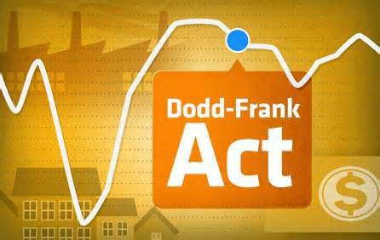
“Accredited Investors”
Current Test (Section 501 of the Securities Act of 1933):
  Earned annual income > $200 K (or $300 K together with a spouse) in each of the prior (2) years, AND reasonably expects the same for the current year; OR
  net worth > $1 million, either alone or together with a spouse (excluding the value of the person’s primary residence)
Time for Re-examination of current test:
  Section 413(b)(2)(A) of the Dodd-Frank Wall Street Reform and Consumer Protection Act requires the SEC to re-examine the definition of “accredited investor” every four (4) years
  SEC re-examining the current test.

Slide 8
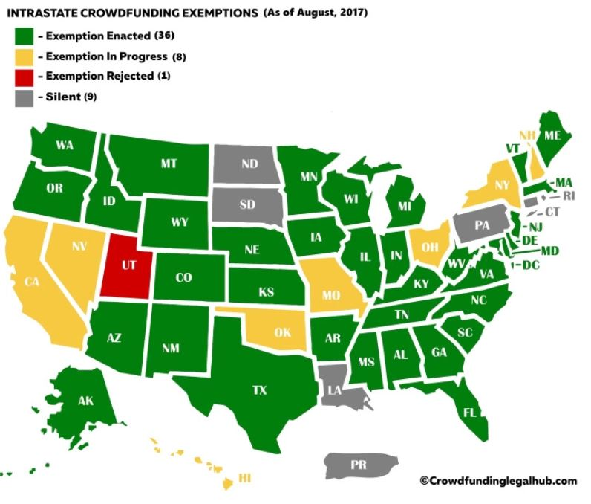
State Regulations (“Intrastate Offerings”)
Intrastate offerings:
  Many states have enacted (or are in the process of enacting) exemptions for “intrastate” crowdfunding offerings
  “Intrastate” simply means that the Issuer and the investors all reside in the same state
  Intrastate exemptions are enacted under Rule 147 and Section 3(a)(11) of the Securities Act as transactions which are not “public”
  Often state statutes have higher cap amounts than the $1 MM Title III cap and significantly less administrative hurdles
State of enacted and proposed Intrastate Exemptions:
  Currently 36 states have enacted an Intrastate exemption and 8 states in various stages of enacting/considering legislation regarding an intrastate crowdfunding exemption
  Proposed Illinois Intrastate exemption available at www.illinoiscrowdfundingnow.com

Slide 9
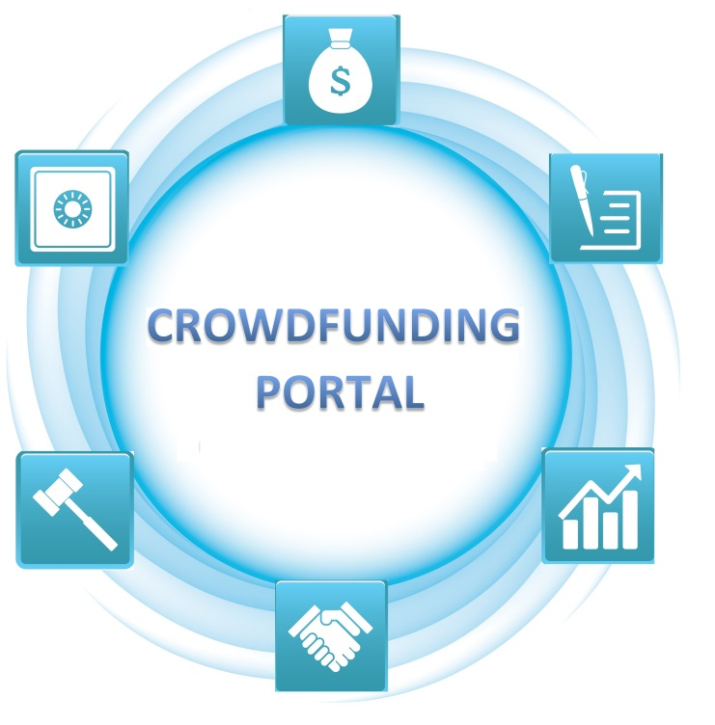
How Does Crowdfunding Actually Work?
All Starts with the “Crowdfunding Portal”:
  “Crowdfunding Portal” just means the website trough which the offering is being made
  Portal is the go between the investors and the Issuer
  Portal is responsible for documentation of the deal as well as the pass through of all informational materials to investor
Differentiation:
  Portals differentiate themselves by type of crowdfunding (e.g. debt, equity, reward, etc.) as well as niche focus
  Most popular niche focuses today center around debt crowdfunding (e.g. “P2P Lending such as LendingClub or Prosper) and Real Estate (debt and/or equity campaigns, e.g RealtyMogul and Fundrise)

Slide 10
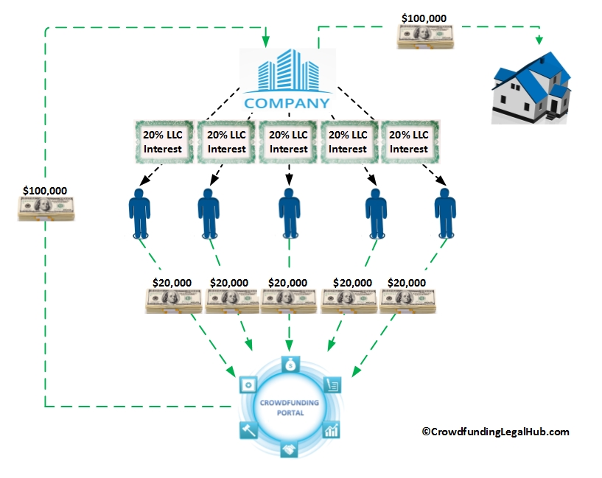
Equity-Based Crowdfunding
What is happening in a Typical Equity-Based Crowdfunding Campaign?
For this example we will assume the subject “campaign” is for an investment in a real estate project (a build and sell project) by a company (here an LLC) set up by a real estate developer specifically for the subject project (the “Company”)
“Crowd” investors decide to invest in the campaign and deposit funds to the Crowdfunding Portal
When the offering is complete, the Crowdfunding Portal transfers these funds to the Company
The Company will use these funds to invest in the subject real estate project
In return for their investment each crowd investor will receive a percentage ownership interest in the Company (and its assets). NOTE: interests are pro-rata here simply for illustration purposes; NOT required

Slide 11
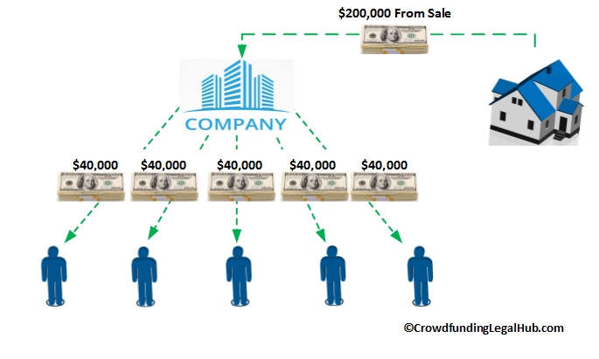
Equity-Based Crowdfunding
How Do Investors Make Money in a Typical Equity-Based Crowdfunding Campaign?
Continuing with the previous example, as “equity” holders investors are betting that they will make a profit upon the eventual sale of the subject real estate project
Upon completion of the underlying real estate project the Company will sell it and the proceeds will go to the Company who will then distribute the proceeds (in this case 100% of the proceeds) to the owners
Each of the investors is an “owner” of a certain percentage of the Company
As a result each investor will receive a pro-rata share of the proceeds from the sale

Slide 12

Equity-Based Crowdfunding - Documentation
1 Transaction – Investor Investment/Subscription in Company
Basic Transaction Documentation:
  Private Placement Memorandum (PPM)
    See CFIRA Recommendations
  Subscription Agreement;
  Operating Agreement (2 classes of interests);
  Escrow Agreement (for transaction proceeds)
Securities Documentation:
  Investor Questionnaire Materials;
  SEC/Blue Sky filings
General Due Diligence:
  Company Organization Documents;
  Company Specific Risks (for inclusion in PPM);
  Company Financials (audited, reviewed, internally prepared);
  “Bad Actor” searches on officers and directors

Slide 13
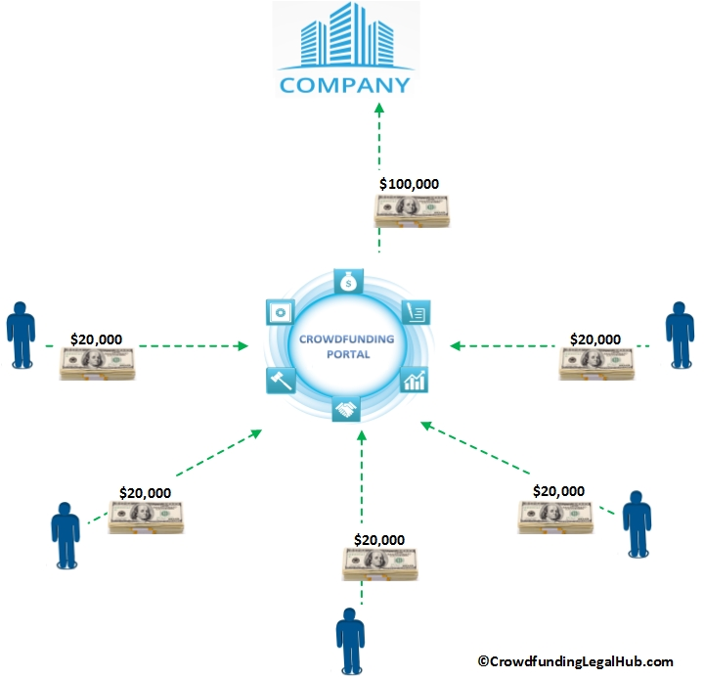
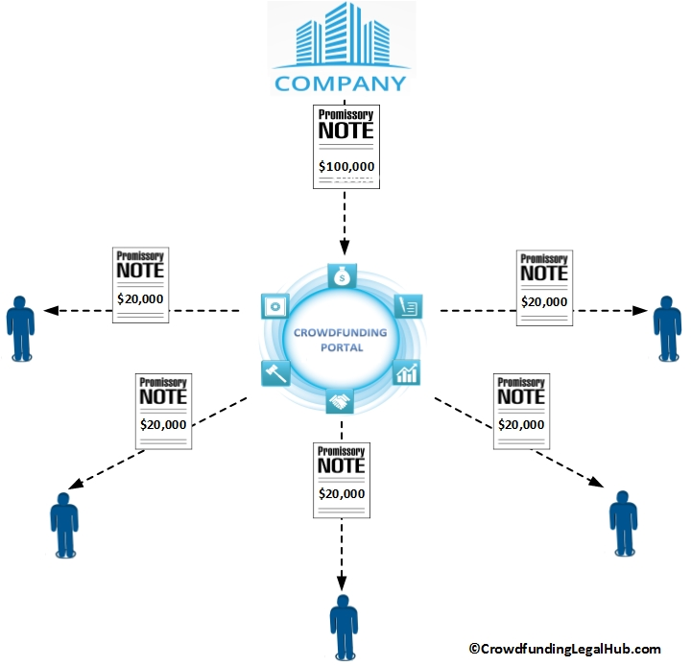
Debt-Based Crowdfunding
What is happening in a Typical Debt-Based Crowdfunding Campaign?
For this example we will again assume the subject “campaign” is for an investment in a real estate project (a build and sell project) by a company (here an LLC) set up by a real estate developer specifically for the subject project (the “Company”)
“Crowd” investors decide to invest in the campaign but here they make a loan to the Crowdfunding Portal
When the offering is complete, the Crowdfunding Portal takes all of the investor funds and makes a loan to the Company
In return for the loan made from the Crowdfunding Portal to the Company, the Crowdfunding Portal will receive a Promissory Note payable by the Company
In return for the loan made from the investors to the Crowdfunding Portal, each investor will receive a Promissory Note payable by the Crowdfunding Portal (e.g. the “borrower dependent notes” discussed later)

Slide 14
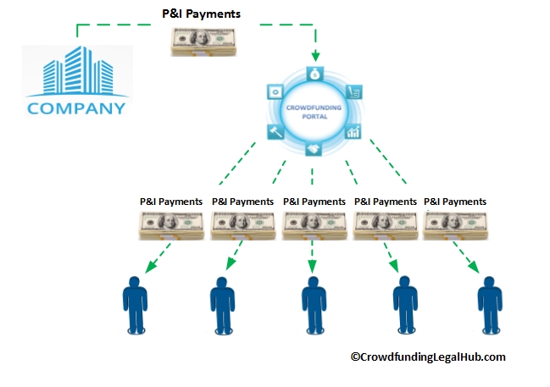
Debt-Based Crowdfunding
How Do Investors Make Money in a Typical Debt-Based Crowdfunding Campaign?
In a typical Debt-Based Crowdfunding Campaign, investors are looking to make money in the way of “interest” payments on the money they are lending
Continuing with the previous example, the Crowdfunding Portal received a Promissory Note payable by the Company (the “Company Note”)
The Company Note will often require the Company to make certain regular (e.g. monthly, quarterly, annually, etc.) payments of principal and/or interest to the Crowdfunding Portal (“P&I Payments”)
Continuing again with the previous example, each investor received a Promissory Note payable by the Crowdfunding Portal (each an “Investor Note”)
Each Investor Note will often require the Crowdfunding Portal to make certain regular (e.g. monthly, quarterly, annually, etc.) P&I Payments to each of the investors.

Slide 15

Debt-Based Crowdfunding - Documentation
2 Transactions:
  Loan from investors to Crowdfunding Portal;
  Loan from Crowdfunding Portal to Company
Basic Documentation For Each Transaction:
  Loan Agreement;
  Promissory Note;
    Investors receive what is referred to as a “payment dependent” (or “borrower dependent”) promissory note.
    A payment dependent note simply means that if the portal doesn’t get paid from the developer, the investor won’t get paid from the portal
  Escrow Agreement (for transaction proceeds);
  Security Documents*
    Including: Mortgage, Assignment of L&R, Security Agreement, Guarantees, Pledge Agreements, etc.
    Enhanced Security Issues when dealing with Construction Loans (including assignments of management agreements, assignment of plans and specs, etc.)

Slide 16

Debt-Based Crowdfunding - Documentation
Securities Documentation:
  Private Placement Memorandum;
    See CFIRA Recommendations
  Investor Questionnaire Materials;
  SEC/Blue Sky filings
General Due Diligence:
  Company Organization Documents;
  “Bad Actor” searches on officers and directors;
  UCC Tax, Lien and Judgment Searches on Borrowing Company/Guarantors;
  Real Estate Due Diligence Materials:
    Surveys;
    Title Commitment;
    Project Documents;

Slide 17

Debt-Based Crowdfunding
Secured v. Unsecued
Many Debt-Based Transactions Are Unsecured To Investor:
  Loan from Crowdfunding Portal to Company is often Secured by some interest
    e.g. Mortgage, Pledge, Collateral Assignment, Security Agreement, etc.
  Loan from Investor to Crowdfunding Portal however is often completely unsecured
    Underlying collateral interest not being passed through to investors
    Investors Receiving only Payment Dependent Note

Slide 18
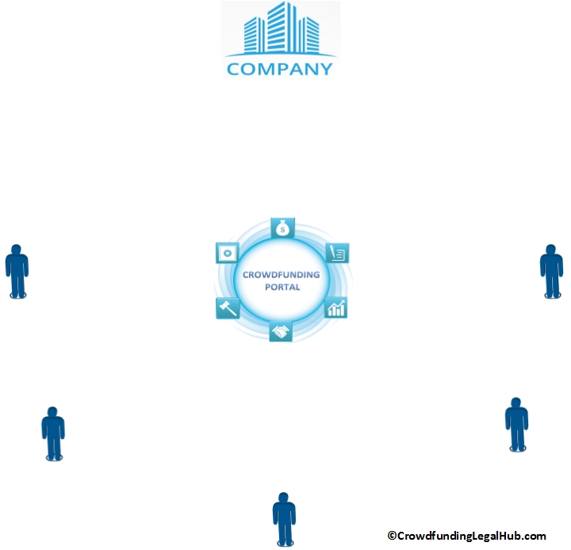
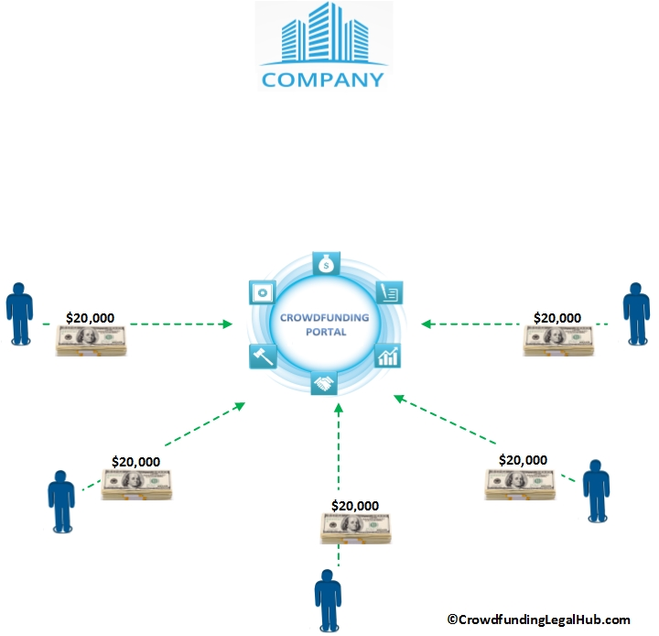
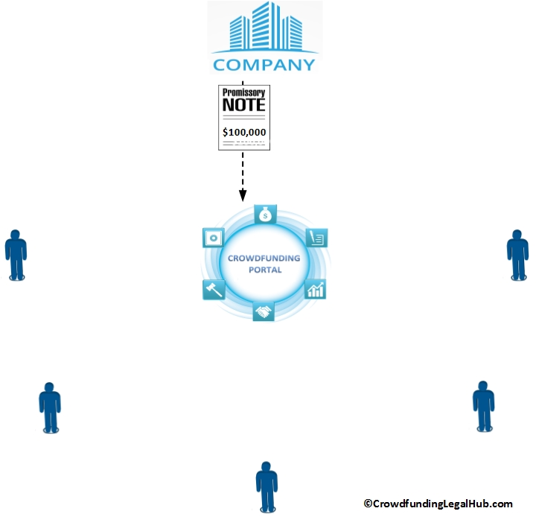
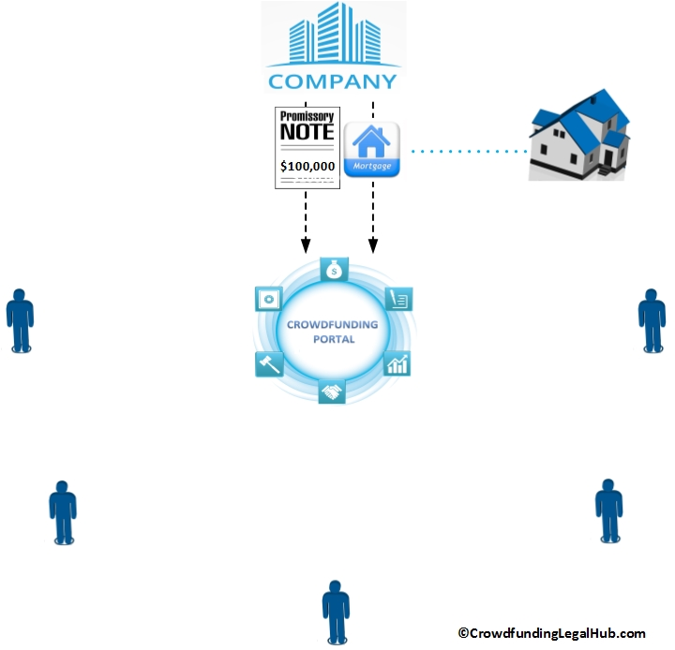
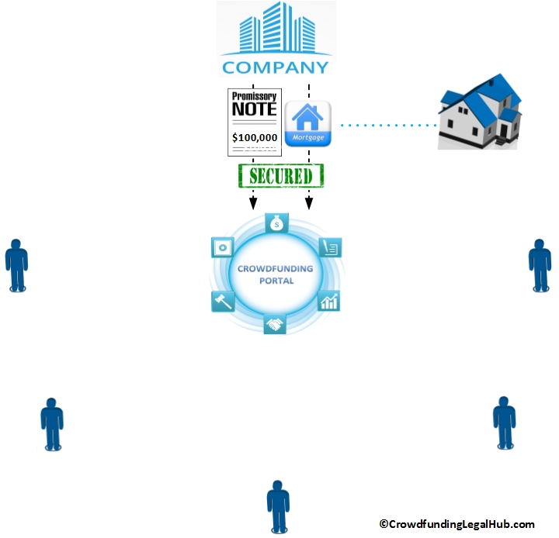
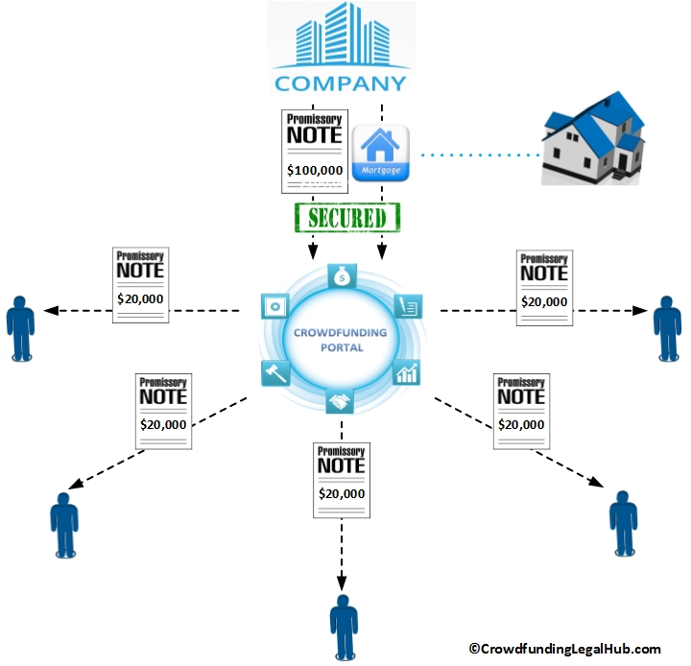
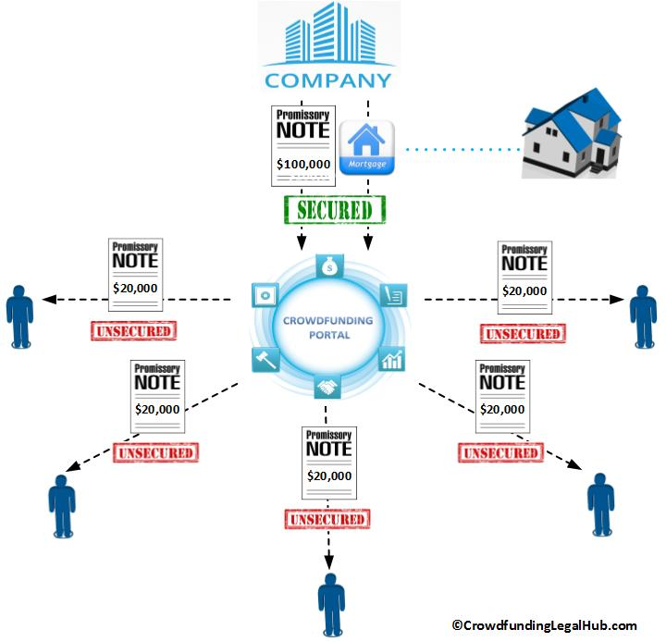
Debt-Based Crowdfunding
Secured v. Unsecued
Typical Debt-Based Crowdfunding Transaction Structure:
For purposes of illustration let’s continue with the previous example of a typical Debt-Based Crowdfunding Campaign
“Crowd” investors make a loan to the Crowdfunding Portal
The Crowdfunding Portal makes a loan to the Company
In return for the loan made from the Crowdfunding Portal to the Company, the Crowdfunding Portal will receive a Promissory Note payable by the Company
They will also typically receive a mortgage encumbering the underlying project
The mortgage will secure the payment of the Promissory Note payable by the Company to the Crowdfunding Portal
Again, in return for the loan made from the investors to the Crowdfunding Portal, each investor will receive a Promissory Note payable by the Crowdfunding Portal to the Investor
These Promissory Notes however are completely UNSECURED. The illustrated mortgage only secures the loan made by loan made from the Crowdfunding Portal to the Company

Slide 19

Debt-Based Crowdfunding
Additional Documentation Considerations
Loan Covenants To Consider:
  General Covenants:
    Ordinary course of business;
    No change of control;
    Delivery of Financials;
    Etc.
  Financial Covenants:
    Debt Service Coverage Ratio;
    Loan-To-Value Ratio;
    Liquidity/Net Worth of Guarantors;
    Borrowing Base (if proceeds not being disbursed in lump sum);
    Etc.

Slide 20

Debt-Based Crowdfunding
Additional Documentation Considerations
Enforcement/Amendment Control Considerations:
  Should be considered like a “participation loan” or “club loan” where the Crowdfunding Portal is acting as the “administrative agent” for the lending investors;
  Consent of “requisite” number of investors should be required for material actions such as waiver of defaults, loan document amendments, enforcement/non-enforcement of collateral documents, etc.
  Currently this is NOT the case; Crowdfunding portal has unilateral control
State Specific Considerations:
  Documents should be set up to include/waive essential state specific provisions and to be effective on a state level;
    Particularly with respect to collateral documents (e.g. use of Mortgage v. Deed of Trust; waiver of community property statutes/consent of spouse; waiver of homestead/farm rights; etc.);
  State Specific Enforcement Rules;
    E.g. California “one action” rule;
  Should have forms reviewed by local counsel

Slide 21
TAKE-AWAYS
    Debt and Equity Crowdfunding are simply “private placements” conducted using general solicitation (or some limited form thereof).
    You need to determine whether the offering will be conducted under a federal or a state exemption as this will determine the notice and filing requirements with respect to securities regulations.
    Crowdfunding rules and best practices are still in flux. When documenting these transactions seek to maximize due diligence and investor protection.
    Be wary of specific state laws which may impact collateral perfection.

Slide 22

Thank You
    QUESTIONS??

